Slide 1
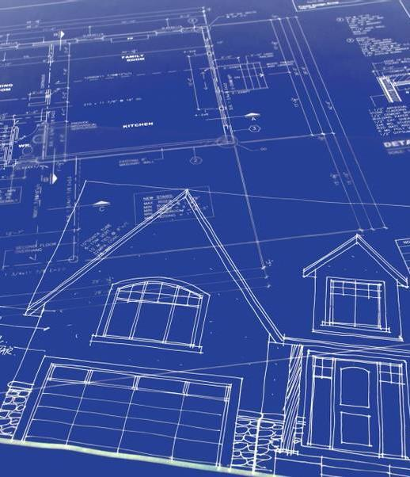
LASER Etch and Cut a Building Model
Ken Mattern
Notes:
I purchased a LASER etching and cutting machine I use it mostly for etching ceramic tiles, cutting boards, basswood and whatever I can fit under the LASER. But I actually bought it for modeling, so I finally decided that I would design, etch, cut and build a model for my railroad.
This clinic will discuss that project. First let’s review the equipment and software I used

Slide 2
Equipment & Software
LASER Equipment
Software
Two Trees 5.5 Watt LASER Etcher & Cutter With Protective Glasses Amazon, $154.00
Dust/Vent Hood Amazon, $43.19
Exhaust Fan GigaParts, $6.99
Air Assist Pump Amazon,$53.99
Less than $300.00 Total
Corel Draw
Export to AutoCad format
LightBurn
$60.00 Used For This Project Better LASER Control
LaserGRBL
Free
Good for General Purpose Etching

Slide 3
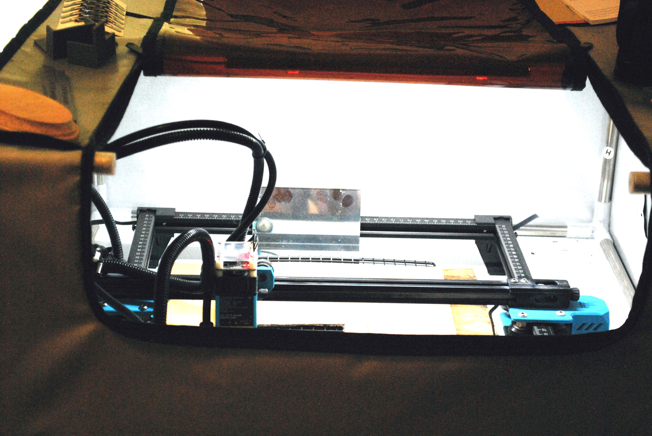
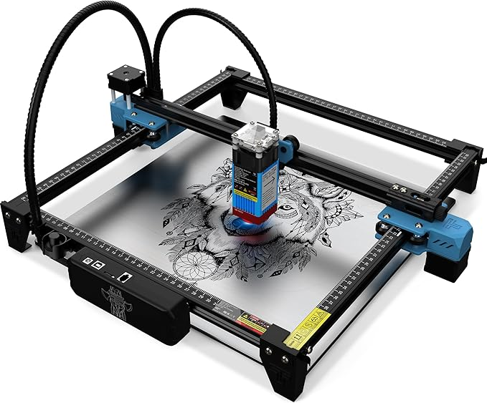
Equipment & Software
LASER Equipment
Two Trees 5.5 w LASER
Dust/Vent Hood with LASER
Notes:
Describe LASER operation
Discuss the need of the hood

Slide 4
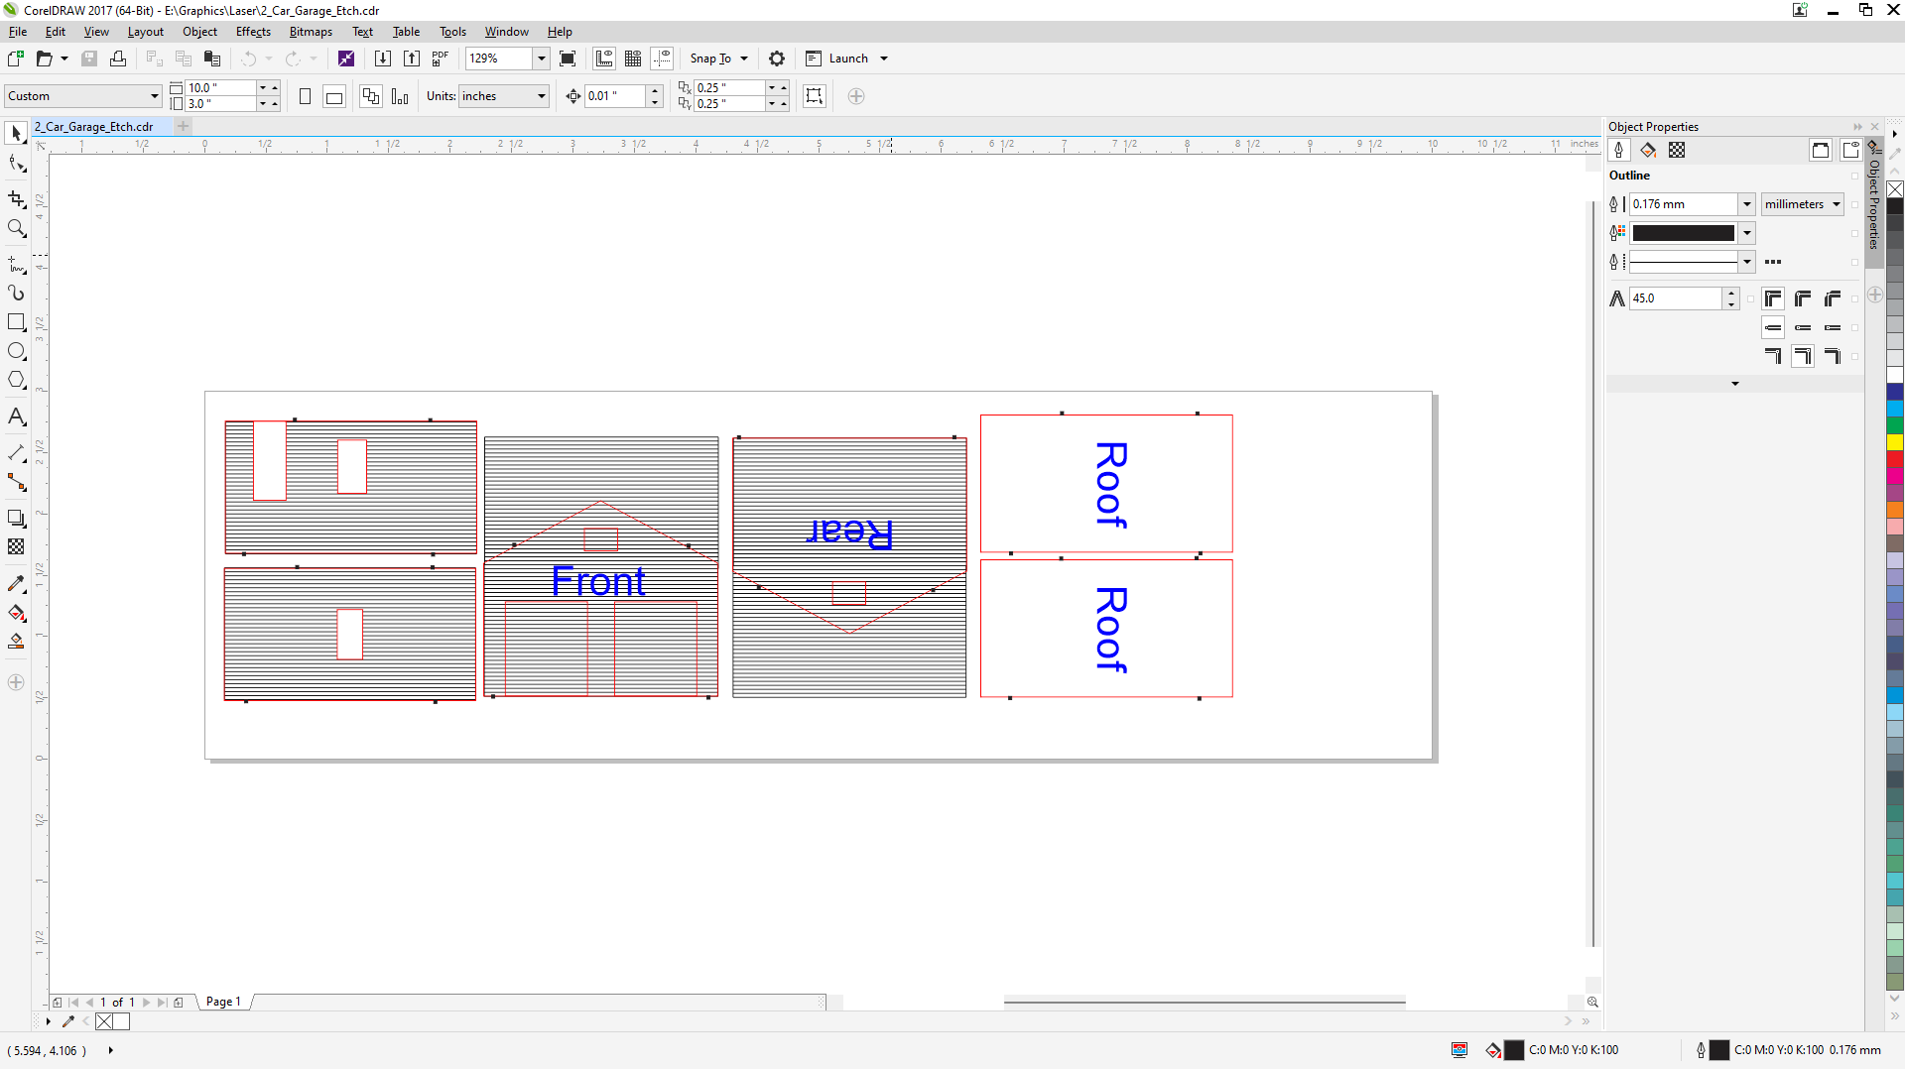
Equipment & Software
Software
Corel Draw
3 colors
Black – Siding Red – Cut Lines Blue – Identify Part
Notes:
Created a 1 column table
Next slide discusses colors

Slide 5
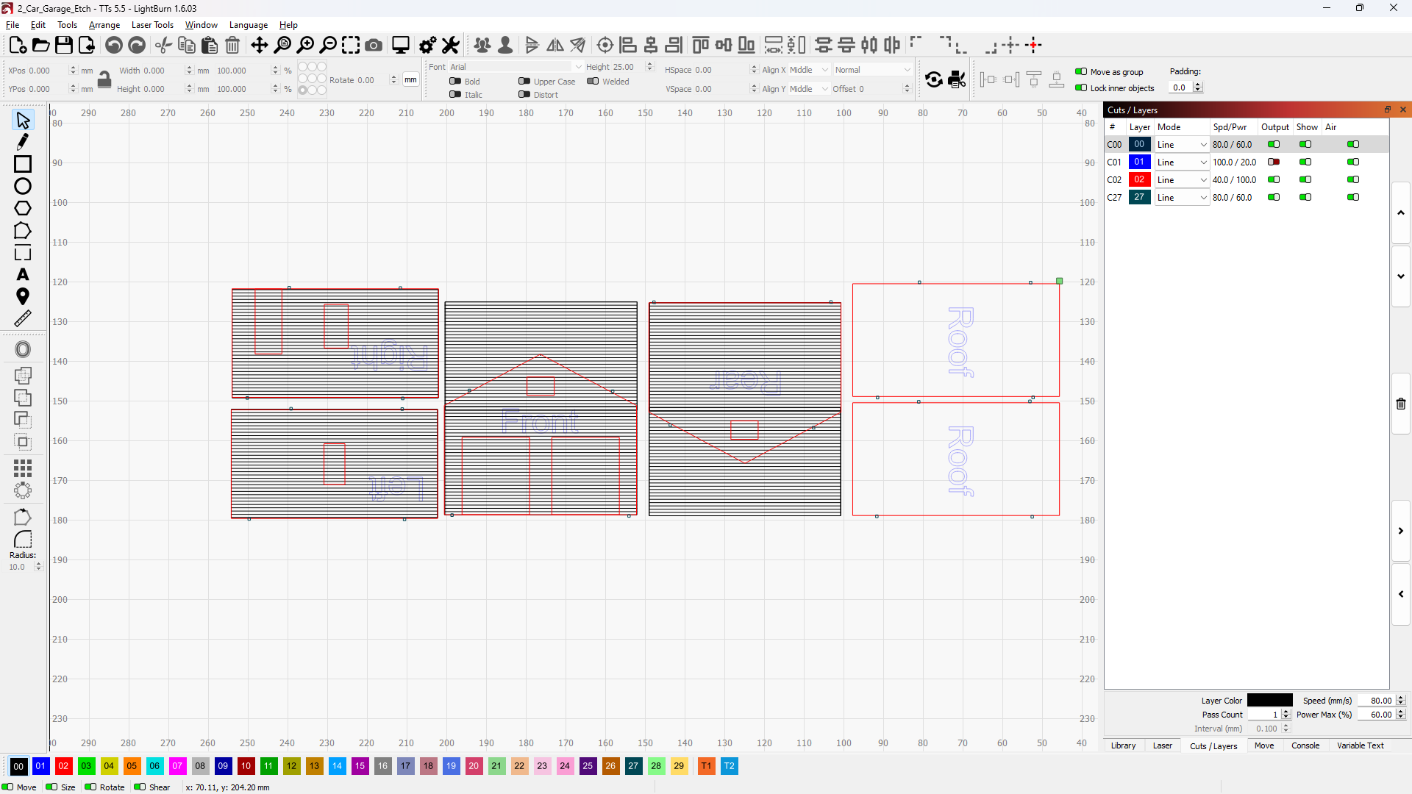
Equipment & Software
Software
LightBurn
3 colors
Black – Etch Red – Cut Blue – Identify Part
Each color is a different etch or cut
Blue is ignored
Notes:
Discuss colors as layers

Slide 6
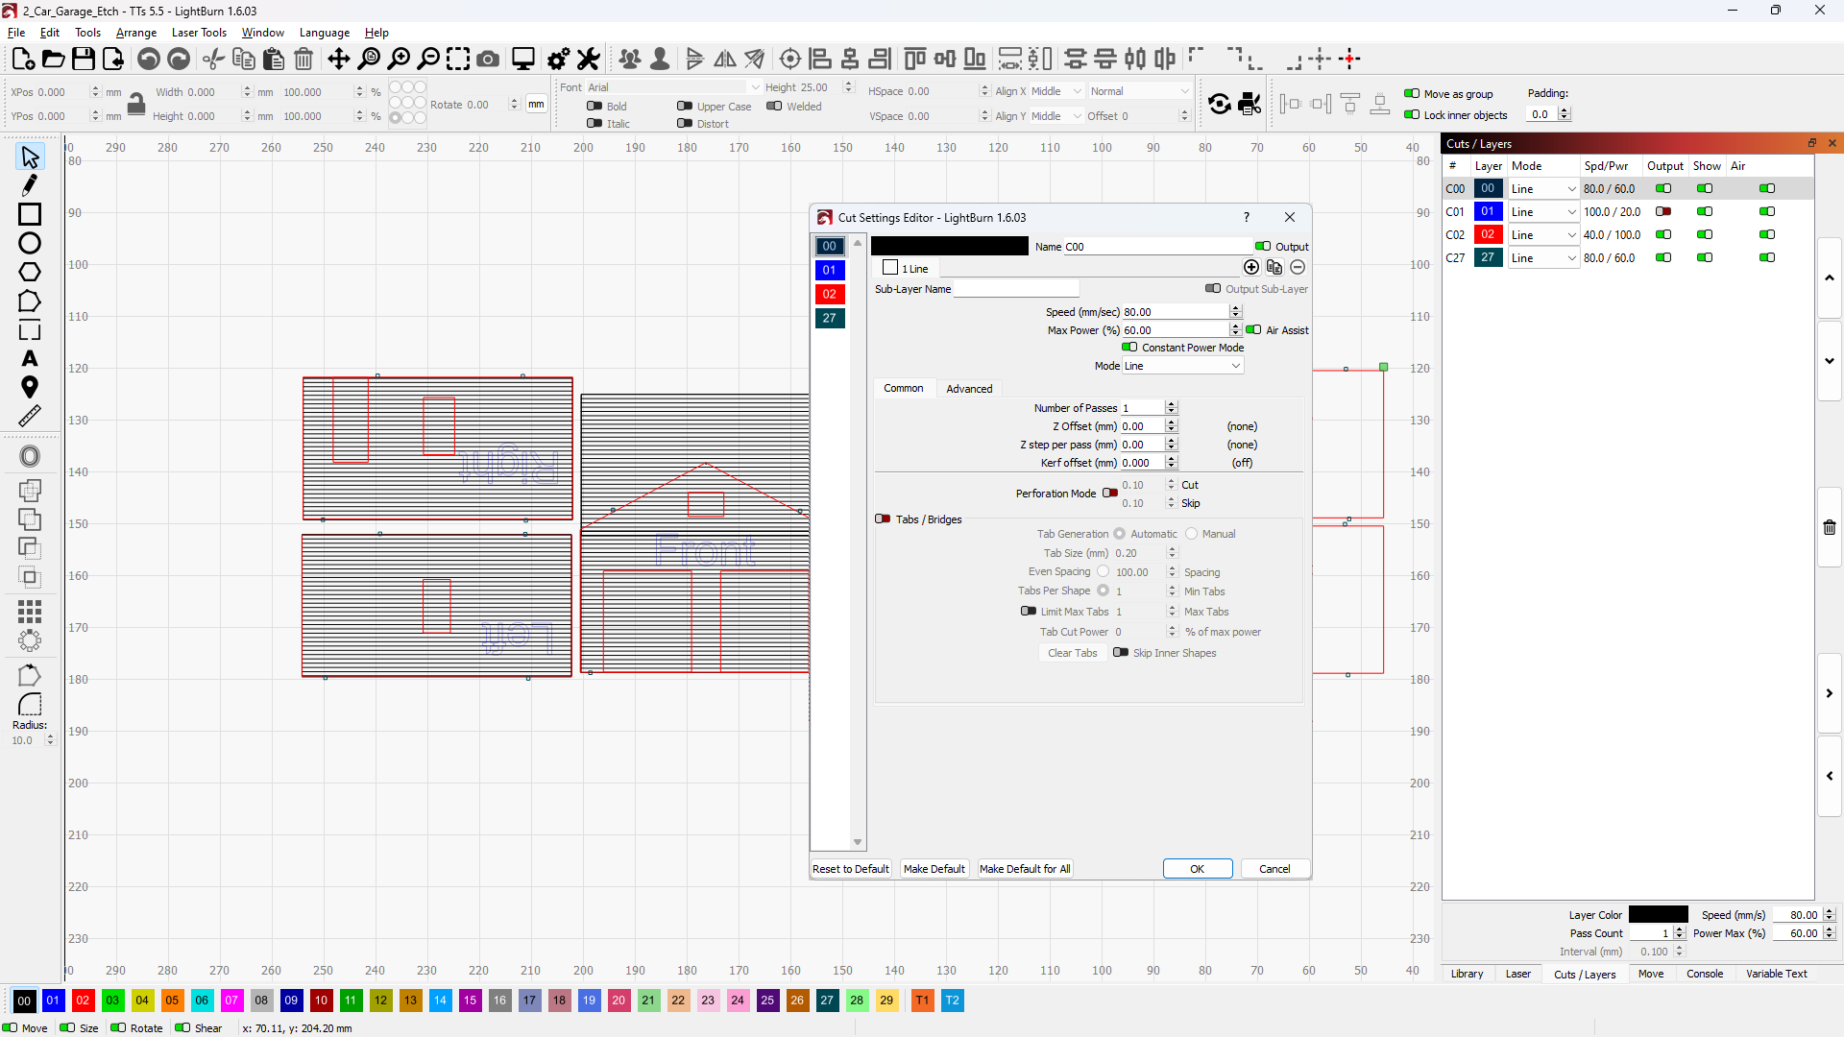
Equipment & Software
Software
LightBurn
Each color represents A different layer
Define speed of LASER head in MM/Sec
Define LASER power in percentage from 0 to 100
Define number of passes

Slide 7
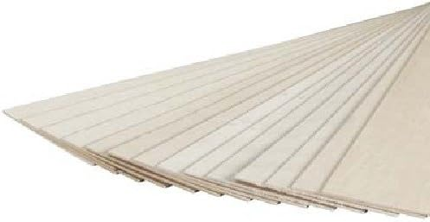
Equipment & Software
Cutting Material
1/32 Basswood

Slide 8
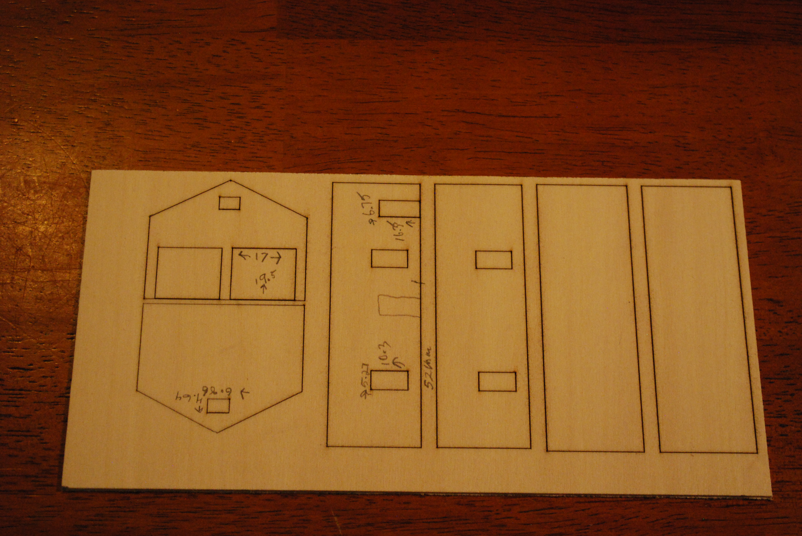
Testing and Cutting
Test #1
1/16” Basswood
Etch outlines only
Determine opening
Sizes after etch
Openings based on
Techy windows and
Doors
Adjust Corel Drawing
Dimensions and note

Slide 9
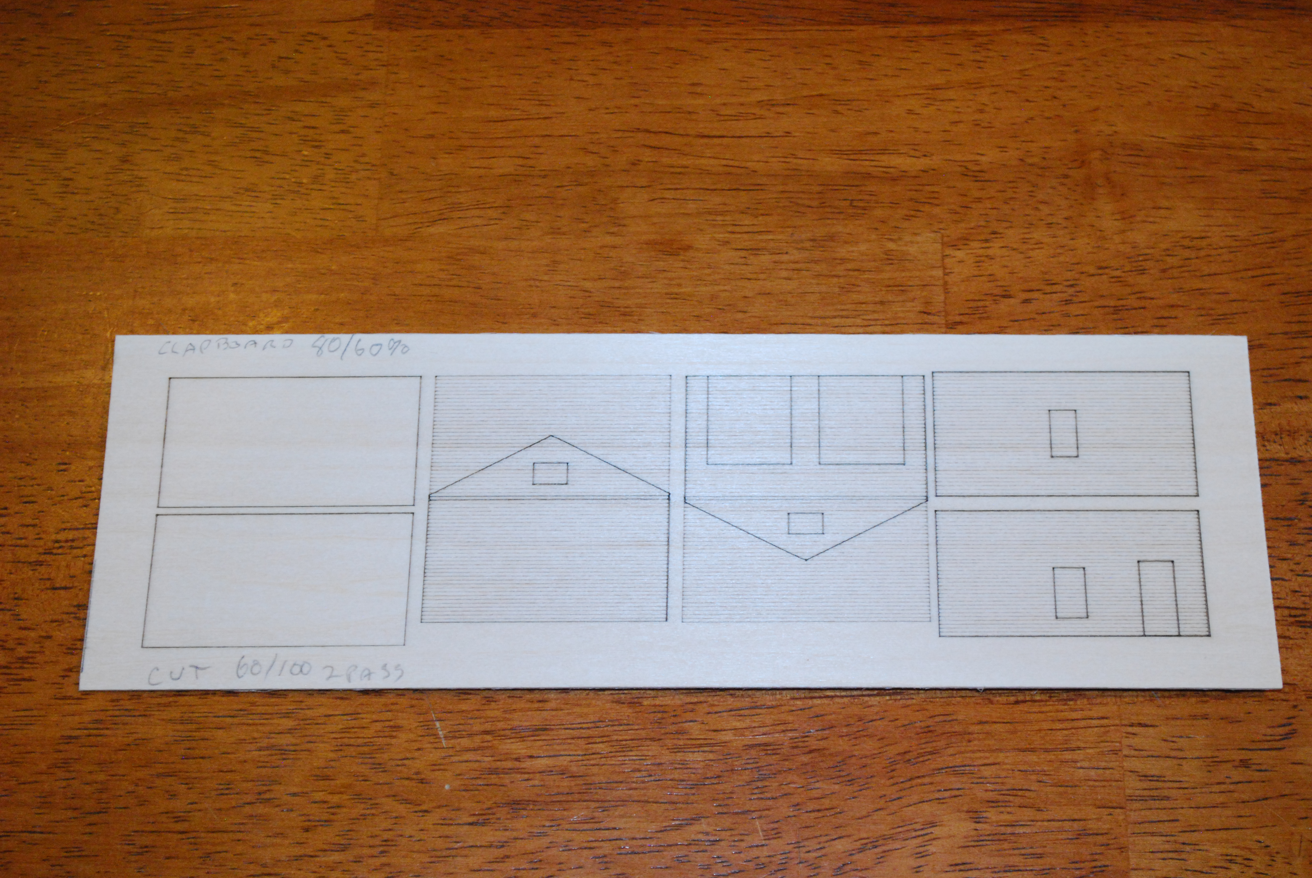
Testing and Cutting
Test #2
1/32” Basswood
Etch everything but
did not cut
Determine clapboard
dimensions and
Look
Mark etch and cut info on board

Slide 10
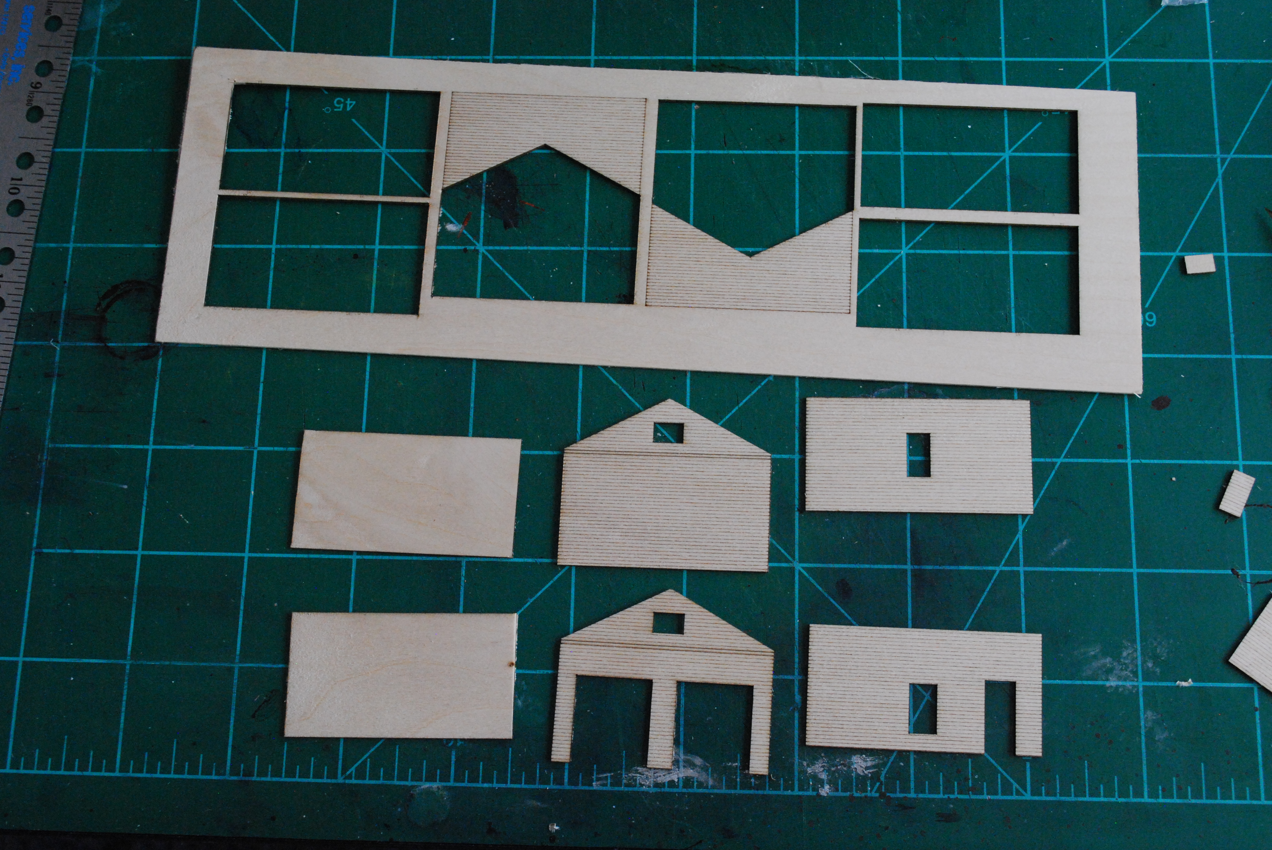
Testing and Cutting
The Result

Slide 11
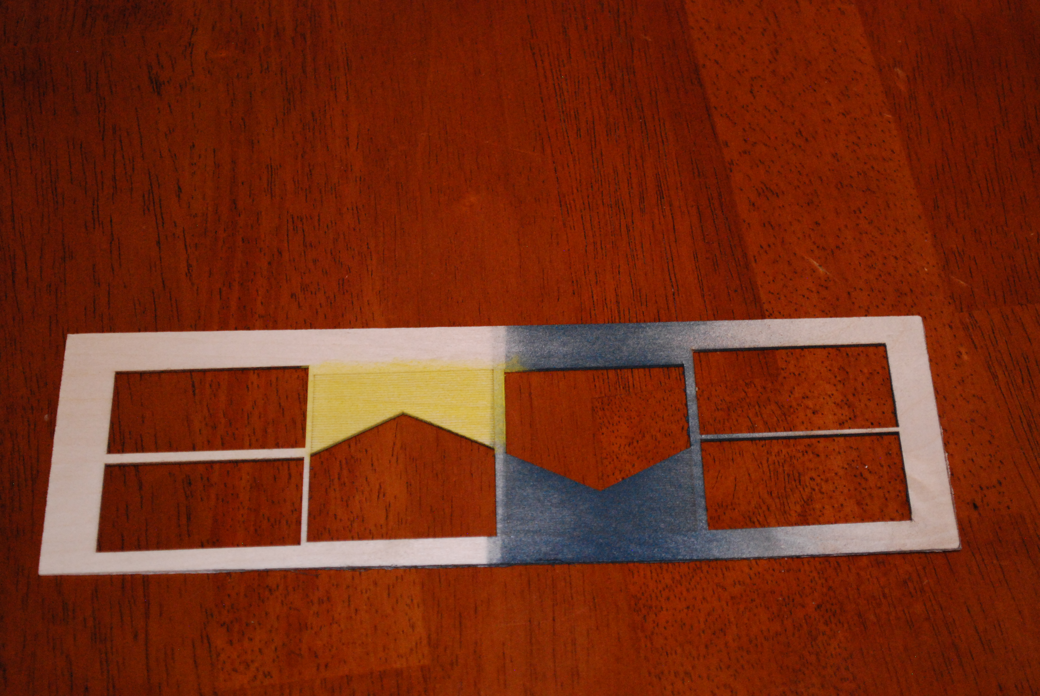
Painting
Test Painting
Concern about
warping
What kind of paint?
Other options
Important to
preserve the visibility
of the siding

Slide 12
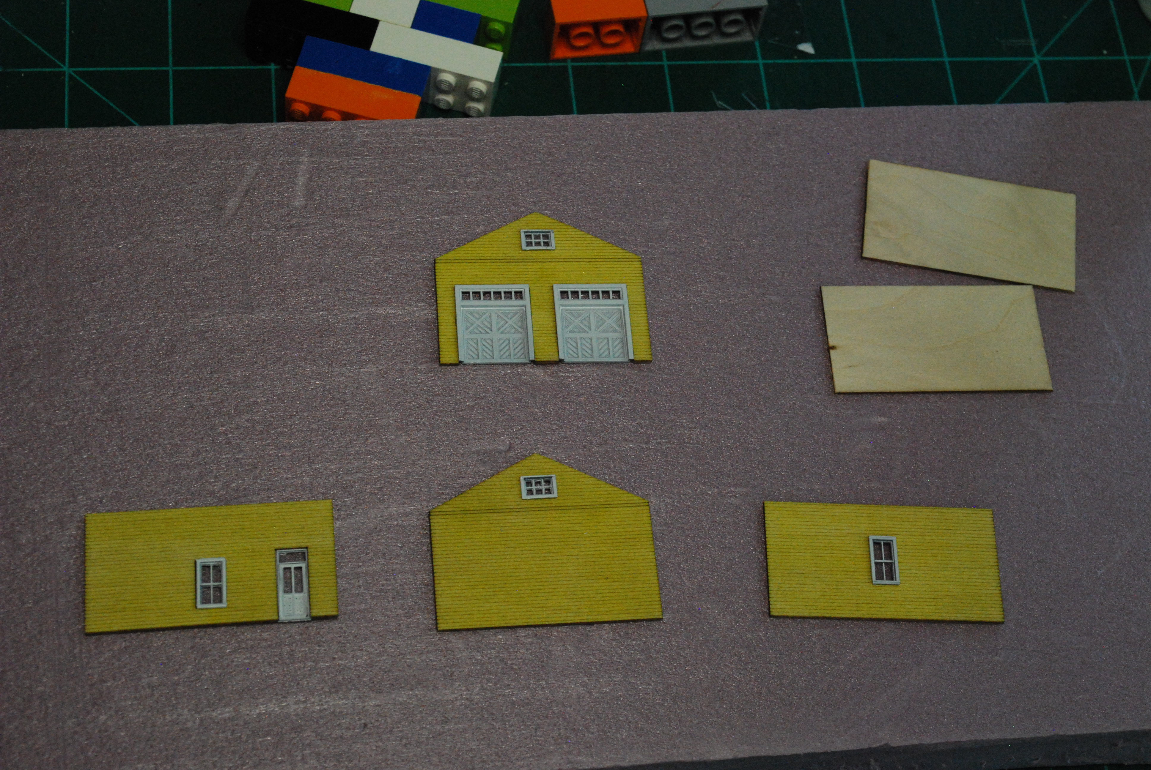
Painting
Final Painting
Use pastel stick chalk and stiff brush
Brush on powder
Spray with Dullcoat
Spray paint doors and
windows white
Windows and doors
snaped in
Glass is clear plastic from
an Atlas turnout package
Used canopy glue

Slide 13
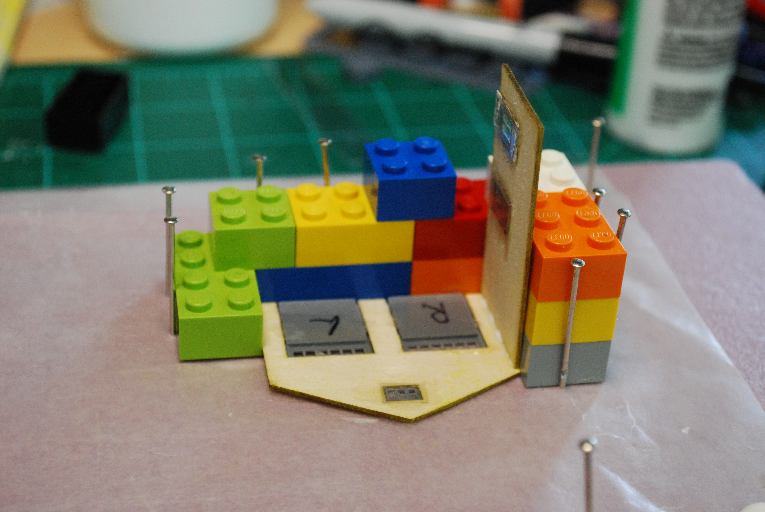
Assembly
Assembly
My favorite assembly
Tool – Legos
Perfectly square and
Infinitely adjustable
Use canopy glue
Assembled on wax
Paper over foam
Pins hold everything
in place

Slide 14
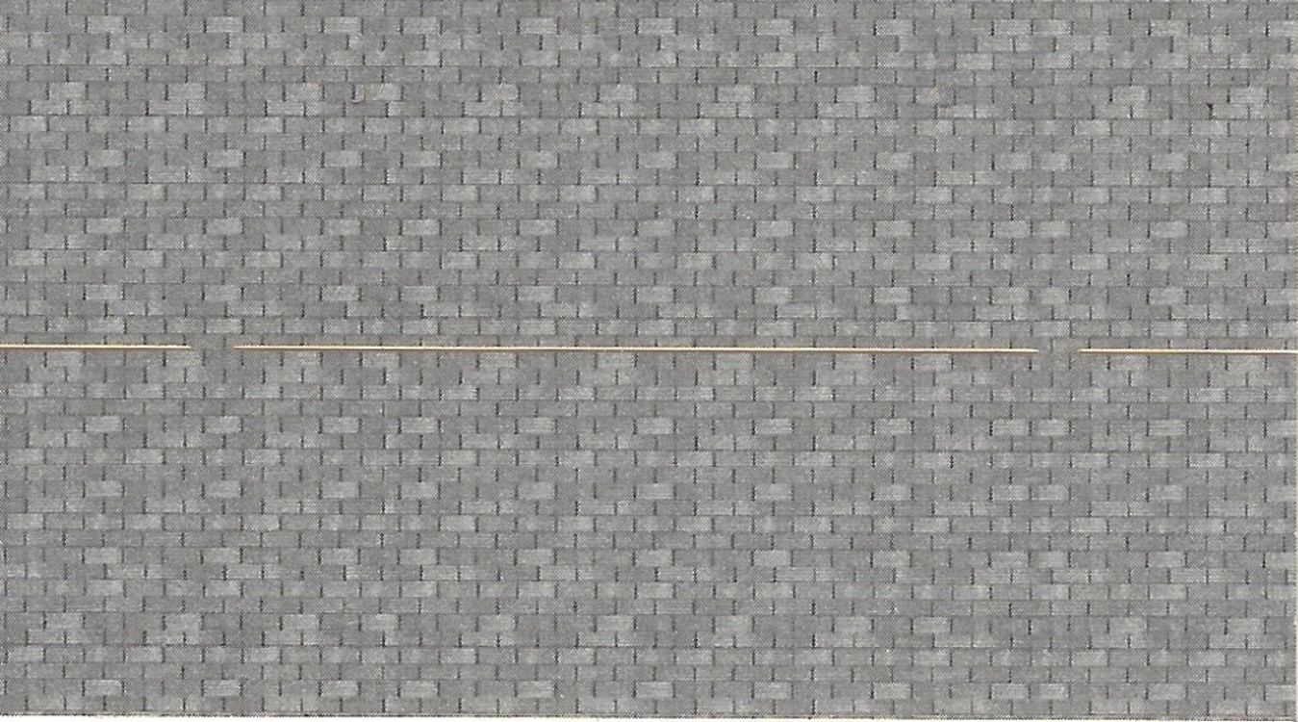
Assembly
The Roof
Scan and resize size shingles
from another kit
Print on peel and stick
shipping label paper
Attach to roof after
assembly

Slide 15
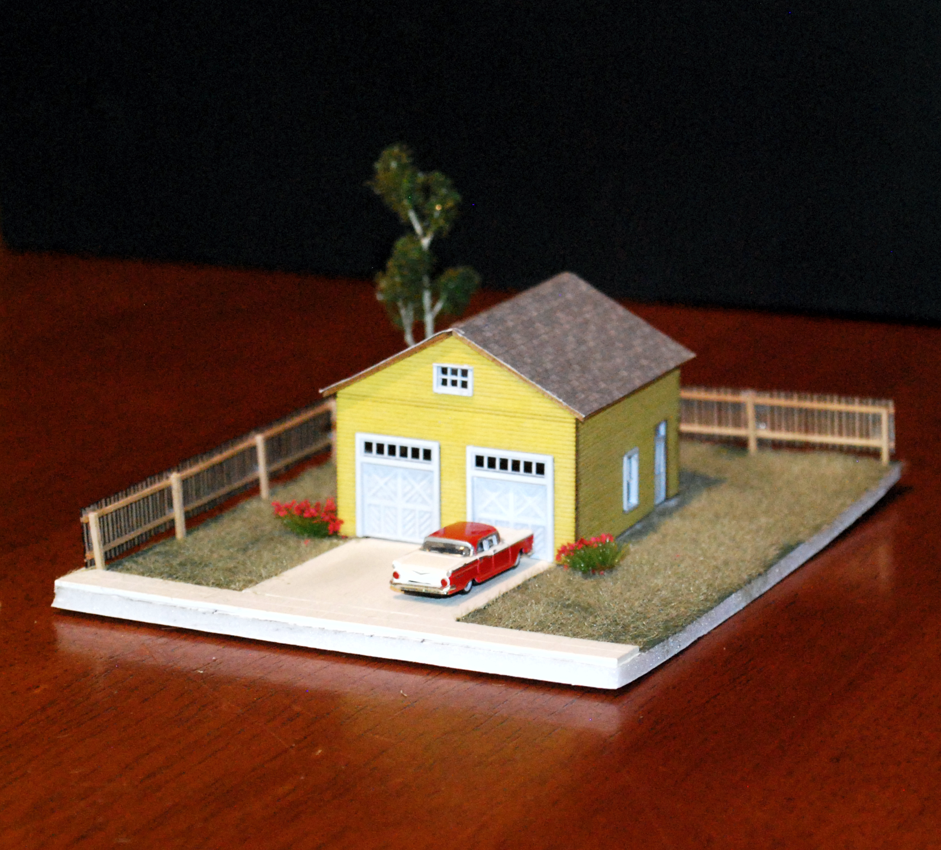
All Finished
And There You Are
A two car garage
LASER etched and
cut
Colored with stick
pastel
Assembled with
canopy glue

Slide 16
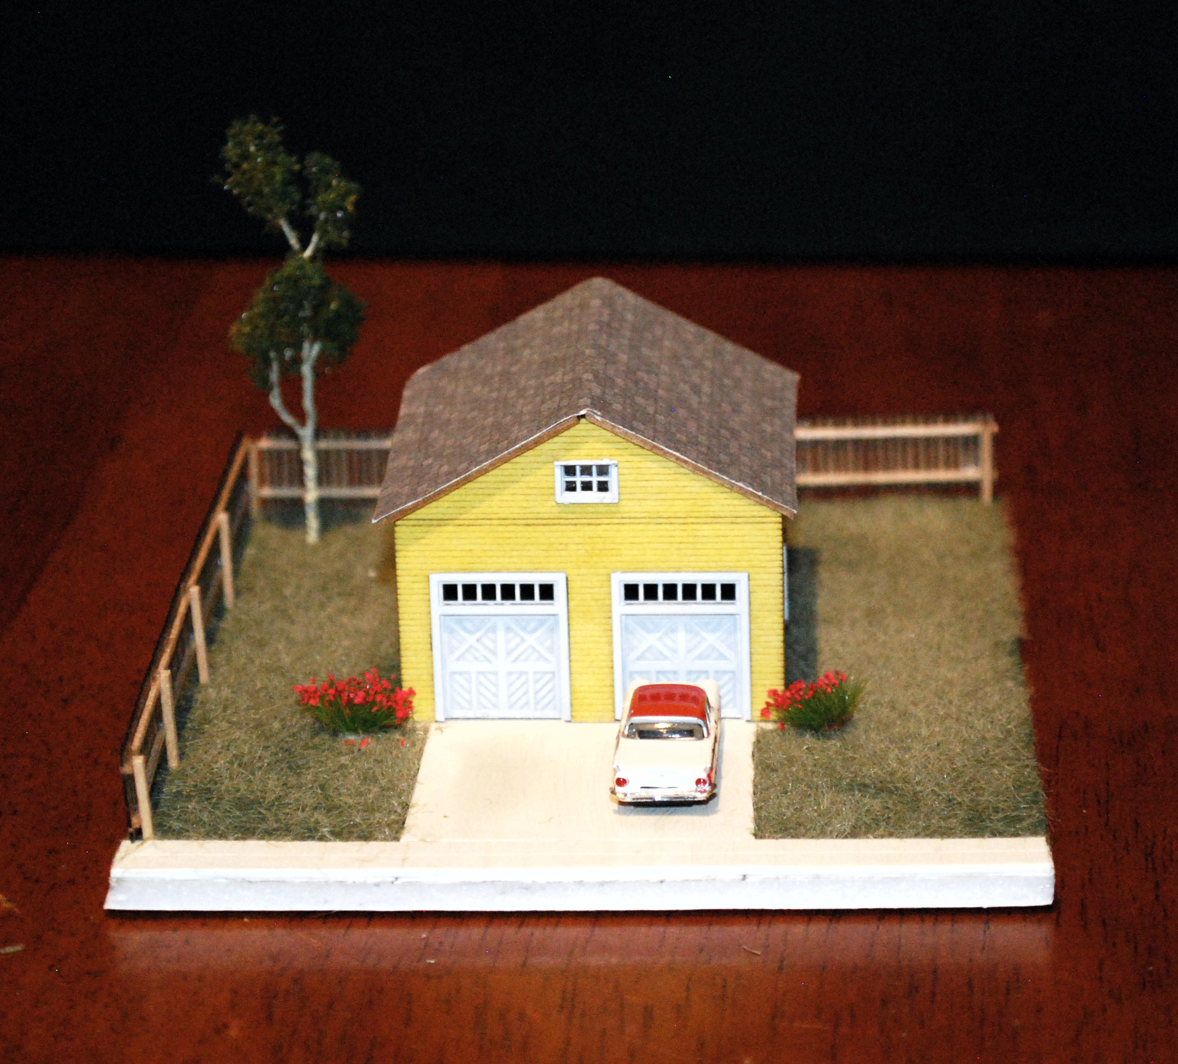
Lessons Learned
Lessons Learned
Measure carefully
I had to redo the roof cuts
Do test etches and cuts
Basswood is inexpensive
Don’t be afraid to redo
Have fun!

Slide 17
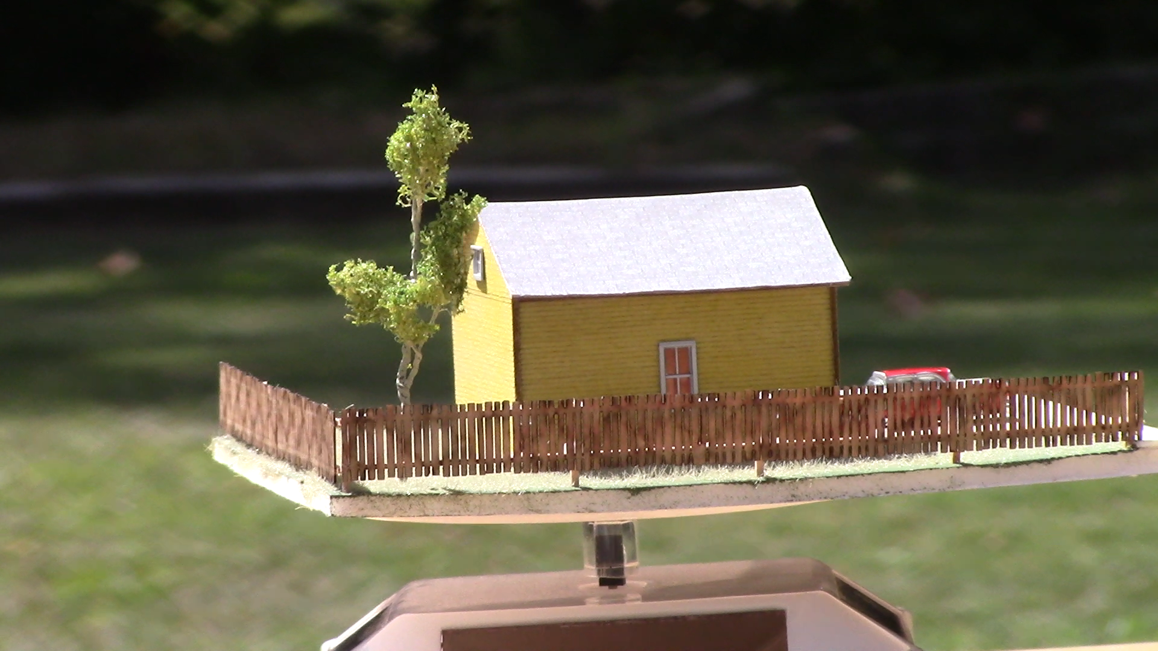
Questions
Questions
?

